Slide 1
Voting And Non-voting Members in Replica Set
Replica set
[up to 50 members]
Voting members -7
Non Voting members – 43
[Read-Only]

Slide 2
Voting And Non-voting Members in Replica Set
Node is eligible for Voting if the below condition are met
Priority – 1
State – Primary / Secondary / Recovering / Rollback / Arbiter

Slide 3
Voting And Non-voting Members in Replica Set
1
1
1
Secondary
Secondary
Secondary
Secondary
Secondary
1
Secondary
1
Primary
Secondary
1
Secondary
1
Secondary
Secondary
Secondary

Slide 4
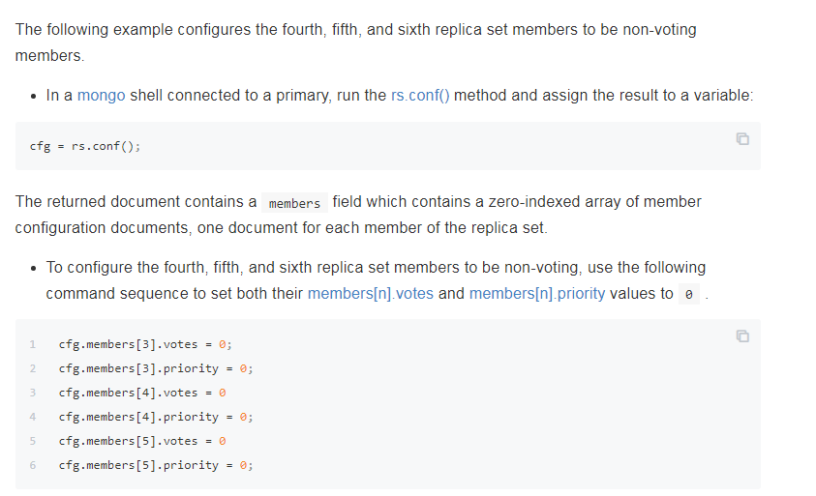
Voting And Non-voting Members in Replica Set
Configure Non-Voting Replica Set Member
Non-voting members allow you to add additional members for read distribution beyond the maximum seven voting members
Non-voting members must have priority of 0.
Members with priority greater than 0 cannot have 0 votes.
To configure a member as non-voting, set both its votes and priority values to 0

Slide 5
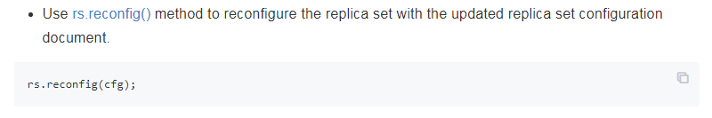
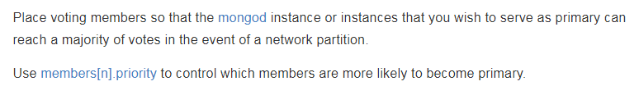
Voting And Non-voting Members in Replica Set

